Slide 1

DCATCH Impact Survey
June 2025

Slide 2
BACKGROUND / CONTEXT
This survey is the third in a series of surveys assessing the impact of changes to Disabled Children’s Access to Childcare (DCATCH) funding.
The previous two surveys were prior to the change to the funding, this survey was specifically to assess the impact after the changes.
The survey had 41 responses in total. Across our 3 surveys on DCATCH there have been 159 responses total.

Slide 3
Questions We Asked
What is the age of your child/children?
What is your child/children’s primary disability?
What are the first four characters of your postcode? (geographic spread)
Did your child/children access childcare supported by inclusion funding (known as DCATCH) in the last year?
Was the support received for pre-school/early years children or school age children?
Is the childcare provider still able to offer additional support without access to the inclusion funding?
If the childcare provider can no longer offer additional support, what effect has this change had on your family?
If the childcare provider can no longer offer additional support, has any alternative provision been suggested?
Are you trying to find a childcare provider at the moment?
If so, what type of care are you looking for?
Does your family receive short breaks support?
If so, please tell us what this is for?
Is there anything else you would like to tell us about your experience of accessing childcare for disabled children and young people?
If you would like from the Childcare team to find a suitable provider, please include your contact details.
Notes:
Locality of Respondents
Outside Calderdale – 5 which represents 2%
Lower Valley – 73 which represents 27%
Upper Valley – 52 which represents 19%
Halifax North & East – 86 which represents 31%
Halifax Central – 59 which represents 21%

Slide 4
Q1 – What is the age of your child/children?
This is the breakdown of the ages we were provided in the survey.
The overwhelming majority (71%) were primary aged children.
Categories are based on the key stages.

Slide 5
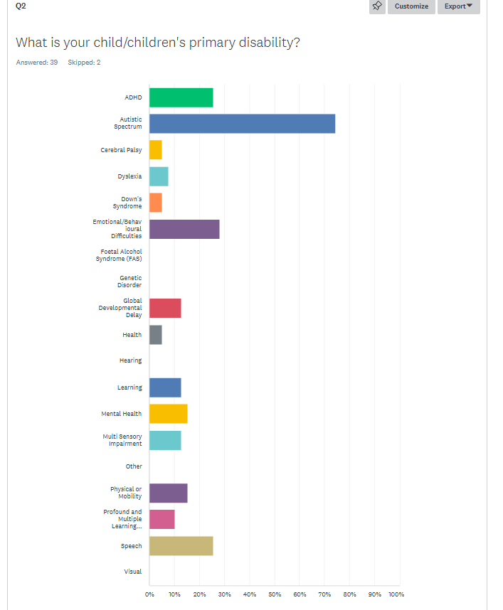
Q2 – What is your child/children’s primary disability?
This is the same list used on things such as the Unique Ways annual survey.
Percentages don’t add to 100% as respondents were able to select more than one response if there was more than one primary disability.
By far the largest selection is Autistic Spectrum, followed by ADHD, Emotional/Behavioural Difficulties and Speech.

Slide 6
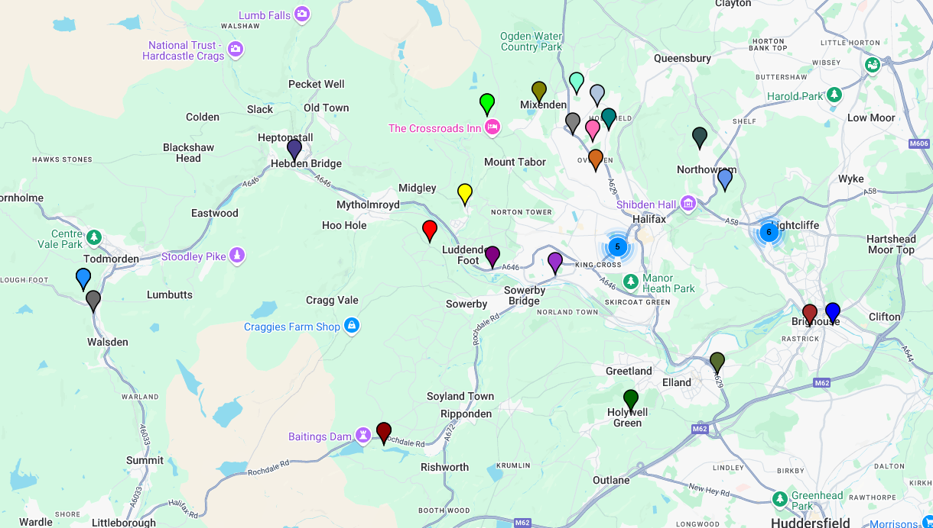
Q3 – What are the first 4 characters of your postcode?
This is the mapping of the postcodes we received from those who completed the survey.
There is a spread across Calderdale, however, some of the most common areas for respondents are north and central Halifax.

Slide 7
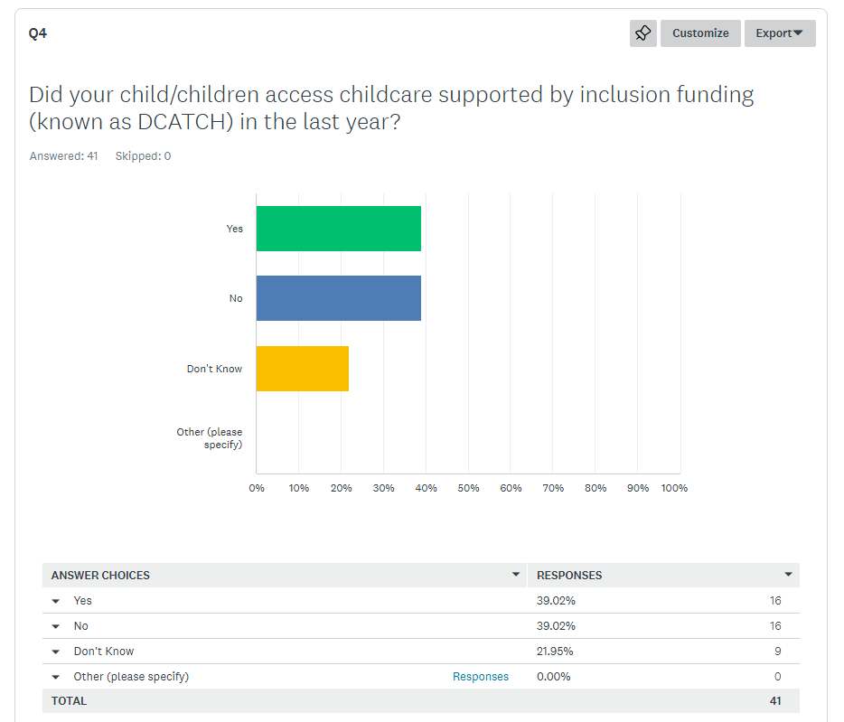
Q4 – Did you child/children access DCATCH funding in the past year?
Of the survey respondents, only 39% confirmed they had accessed DCATCH in the past year.
A further 22%, however, did not know whether they had accessed DCATCH in the past year.
Of those who selected no, they may have accessed DCATCH in previous years and the comments seem to indicate this.

Slide 8
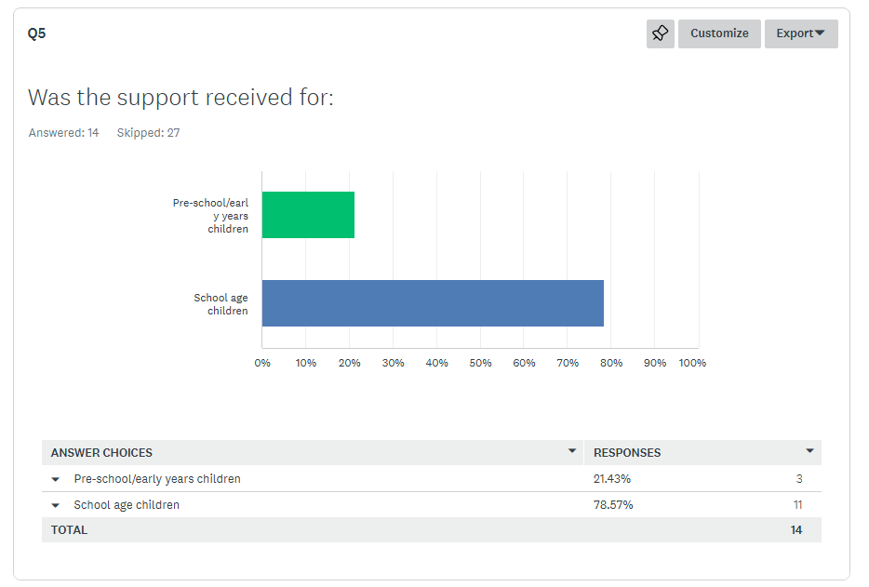
Q5 – Was the support received for pre-school/early years children or school age children?
Overwhelmingly, the support was received for school age children.
However, we acknowledge this is a small sample size.

Slide 9
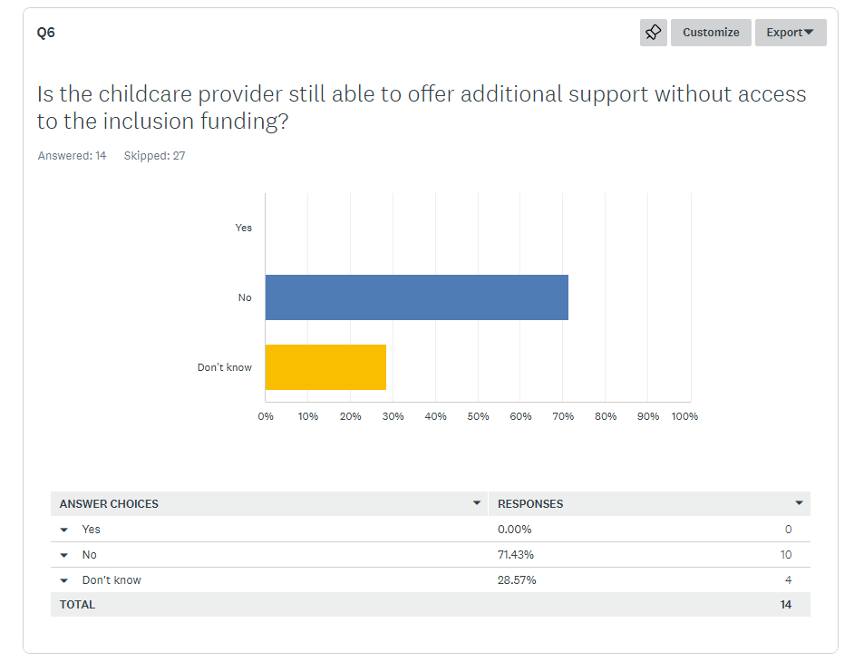
Q6 – Is the childcare provider still able to offer support without access to the inclusion funding?
Of those who answered this question, none of them indicated that the childcare provider was still able to offer support without access to inclusion funding.
71% said no, with the remaining 29% unsure.

Slide 10
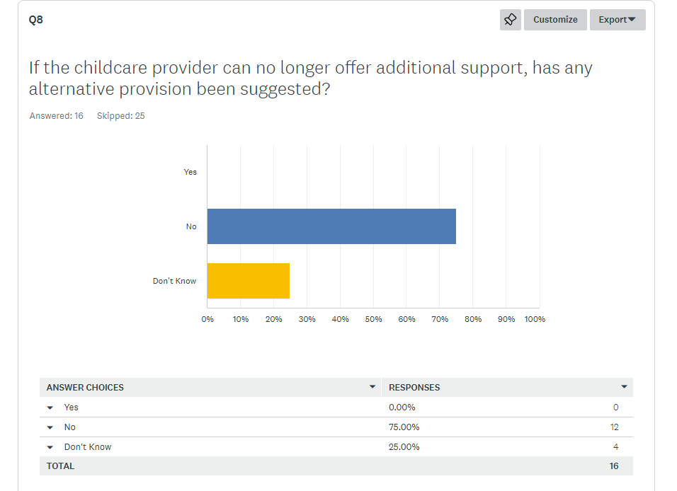
Q8 – If the childcare provider can no longer offer support, has any alternative provision been suggested?
Of those who answered this question, none of them indicated that alternative provision had been suggested.
75% said no, with the remaining 25% unsure.
This largely corresponds to the answers to question 6.

Slide 11
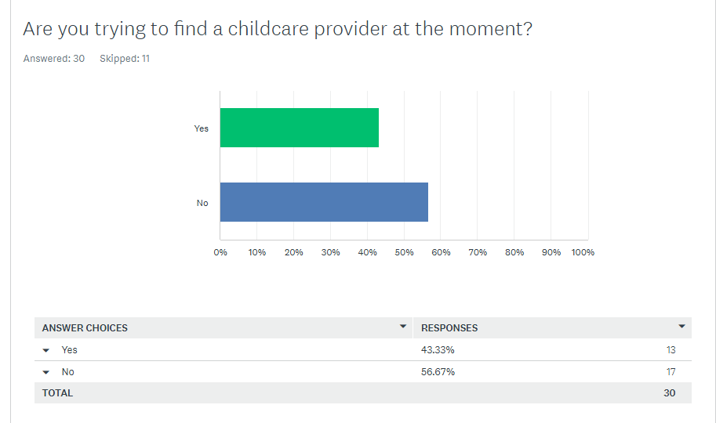
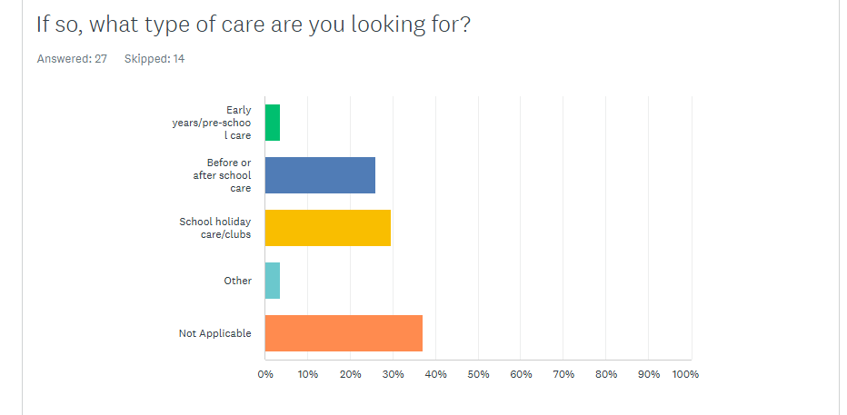
Q9, 10 and 14 – Childcare Provider Questions.
Question 9, 10 and 14 were all linked to whether survey respondents were trying to find childcare, and to offer support if they were.
13 respondents were trying to find a provider.
Of those looking for care (excluding those who selected non applicable), 47% were looking for holiday care, 41% were looking for before or after school and the other selections were early years care or other.
We also asked for some contact details to be left so we could have the childcare team get in touch and offer them support if they so wished.

Slide 12
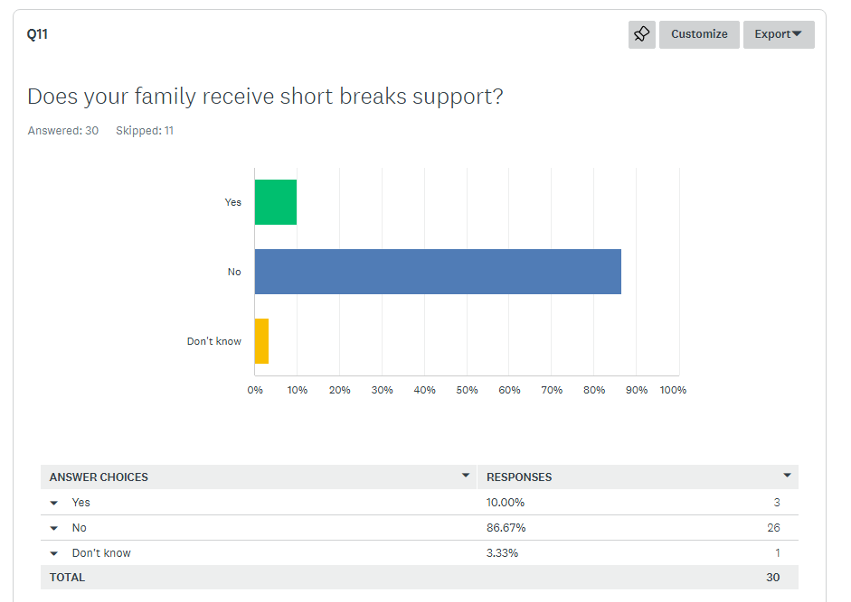
Q11 and 12 – Short Breaks Support.
We asked if the respondents received short breaks support and if they did, what the support was for.
Only 3 respondents who answered this question received Short Breaks Support.
Of those who received it:
  One used it to get ‘out and about’ but couldn’t use it for childcare.
  One said their package wasn’t functional due to low hours, PA recruitment issues and the child being seen as too high need to access oversubscribed outreach services. They have had a poor experience.
  One had a package for community activities after school and during the holidays for one child, and a lower level for community holiday activities for another child.

Slide 13
Questions & Lessons
The evidence is clear that this has had a large impact on families with disabled children throughout Calderdale.
Whilst made in the context of a saving, there are a lot of comments that specifically reference the financial impact this has had on families. This includes references to taking unpaid time off work, leaving a job entirely or having to make adjustments to how they work (change of hours etc). Impact on a Parents ability to work was mentioned 11 times in comments on the survey, out of 35 comments in total. This is nearly 1/3 of all comments.
The majority of survey respondents had Children/Young People of Primary School age. Whilst some respondents did access Short Breaks, we know Short Breaks funding generally goes to those with older Children/Young People.
There are several references to group and/or mainstream provision being unsuitable, and DCATCH being able to fund things like 1 to 1 support which has now gone, meaning the Child/Young Person is accessing little to none of these kind of activities.
A large proportion of respondents have shared the changes they have had to make to support their child. This includes changes to working patterns, changes to how they access childcare and changes in routine. This also includes how childcare providers have changed their behaviours, including doing additional work without additional funding. There may be the potential that over time these pressures accumulate and most providers and families are impacted.
This lends to some questions:
Is there a wider financial impact due to DCATCH affecting many Parent Carers ability to work, above and beyond the expected savings?
Is there a cohort who now miss out on DCATCH but also are unable to get Short Breaks who are disproportionately impacted?
Can Childcare settings be inclusive without the funding to do so, and how could this be supported?
The impacts may have been mitigated by the good will and support of families and providers. Is this sustainable and what will the impact be if this good will erodes?
What are the impacts on attainment, outcomes and general wellbeing for the Children/Young People and Families affected?

Slide 14
ABOUT FAMILY VOICE CALDERDALE
Family Voice Calderdale is supported and hosted by Unique Ways and is the Parent Carer Forum for Calderdale.
All Parent Carer Forums are members of the National Network of Parent Carer Forums and Contact (formerly Contact A Family).
The aim of Family Voice Calderdale is to ensure that services within Calderdale meet the needs of disabled children and their families
We do this by representing the voices of the Parent Carers of Children and Young People with SEND in Calderdale, and by having Parent Carer Representatives sit on Strategic Partnerships throughout Calderdale.

Slide 15

KEEP IN TOUCH
Emma Baker
Family Voice Calderdale – Volunteer Chair
familyvoicechair@uniqueways.org.uk
Kirsty Penney
Family Voice Calderdale – Volunteer Vice-Chair
familyvoicechair@uniqueways.org.uk
Joe Thompson
Family Voice Calderdale – Project Co-Ordinator
joe.thompson@uniqueways.org.uk
01422 343 090
Working pattern: 9:30-3:30, Tuesday to Thursday
Unique Ways, Hanson Lane Enterprise Centre, Hanson Lane, Halifax, HX1 5PG
Company Number: 05098716 | Charity Number: 1109413

