Slide 1

Sensory Survey 2024

Slide 2
BACKGROUND / CONTEXT
On the 31st October 2024, Family Voice Calderdale & Unique Ways sent out the Sensory Survey to Parent Carer Members of the charity. The purpose of this specific survey was to gather information on the experiences of Parent Carers with sensory services in Calderdale, and their wider understanding of this area.
Number of recipients of the survey: 1836
Number of completed surveys: 358
This survey had 358 responses, which is the highest for some time on one of our surveys, and represents approximately 19.5% of survey recipients.

Slide 3
Questions We Asked
How much do you know about ‘sensory processing’ and the different senses involved?
Which sensory help, advice and services are you aware of in Calderdale?
Which sensory help, advice and services have you used for your child?
Do you feel your child would benefit from a sensory assessment?
If yes, how do you think your child would benefit from having an assessment?
Has your child already had a sensory assessment?
Please provide any additional comments about your child’s sensory assessment.
If yes (to Q6), how did the process go?
If yes (to Q6), who carried out the assessment?
Have you ever had to pay privately for sensory help, advice or services for your child?
If yes, what was the main reason for doing so?
If yes, how much did you pay?
If yes, what did you pay for and where?
Have you ever submitted an Individual Funding Request (IFR) for a sensory assessment through your GP?
If yes, what was the outcome of this request and what were the reasons given?
Which areas of sensory processing does your child have challenges with?
Does your child have any needs or disabilities in addition to Sensory Processing challenges?
Would you benefit from sensory awareness-raising or training, or more understanding of sensory challenges to better support your child?
If yes, what specific areas would you like to learn more about?
What types of sensory services do you feel would benefit you but are not available locally?
Please leave your name and email address if you would be happy to be contacted about your answers?
Any final comments?
Notes:
Locality of Respondents
Outside Calderdale – 5 which represents 2%
Lower Valley – 73 which represents 27%
Upper Valley – 52 which represents 19%
Halifax North & East – 86 which represents 31%
Halifax Central – 59 which represents 21%

Slide 4
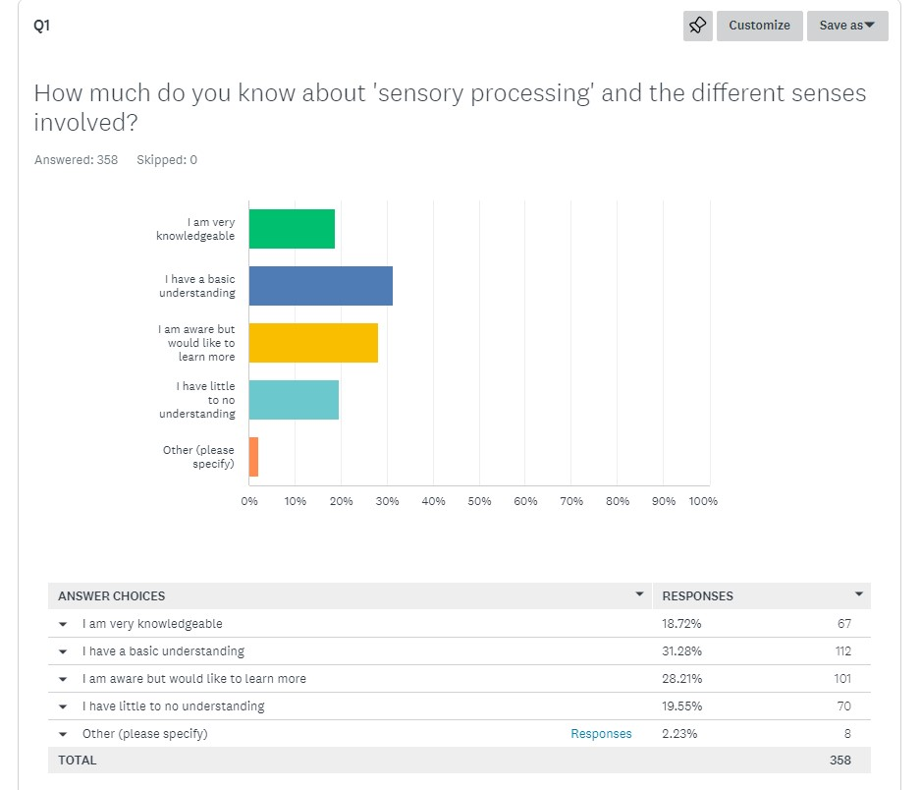
RESPONSES - Q1 ‘How much do you know about sensory processing and the different senses involved?’
Of respondents, approximately 80% have anything from a basic awareness to a lot of knowledge about sensory processing.
However, of respondents, only 19% indicated they had a lot of knowledge on the topic.
20% of respondents indicated they have very little or no understanding.
There were a few responses in ‘Other’:-
“I have knowledge via my job role.”
“My son is autistic and has a lot of sensory needs so I know a little bit about it.”
“Never heard of it.”
“I know a fair amount, but could know more.”
“In between basic and very [knowledgeable].”
“[I know] only because I have a child with severe sensory processing and it’s been a tough process to get diagnosis.”

Slide 5
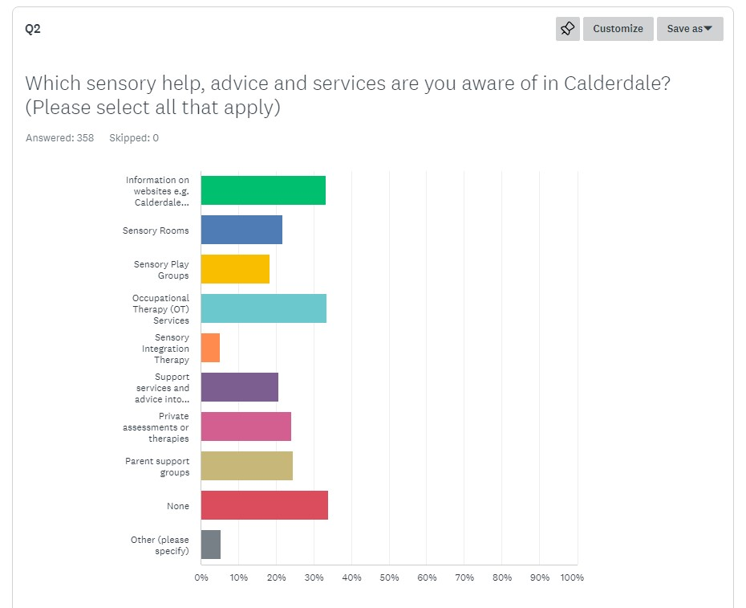
Q2 – ‘Which sensory help, advice and services are you aware of in Calderdale?’
There was a decent spread of what services respondents were aware of, and many respondents were aware of multiple services.
However, approximately 34% were not aware of any existing sensory services in Calderdale.
There were a few answers in ‘Other’, which we will go through in the next slide.
33.24%
21.79%
18.44%
33.52%
5.03%
20.67%
24.02%
24.58%
33.80%
5.31%

Slide 6
Q2 CONT – ‘Which sensory help, advice and services are you aware of in Calderdale?’
Responses to ‘Other’:
“I know about coffee mornings or afternoons at Unique Ways.”
“I’ve had no help.”
“Family Support.”
“Finding information and signposting parents is part of my job role.”
“Services previously used.”
“Calderdale does not provide sensory OT therapy.”
“There’s not enough information out there for parents with disabled children, [it] feels quite isolating.”
“Only help I see is Parent Groups.”
“Calderdale have no proper sensory services available, which is much to children’s detriment. Calderdale Council and the ICB block these wherever possible, even when recommended in professional reports.”
“Just feel like there is no help.”
“I have not been informed about any of these [support services.]”
“Although I’m aware of some of the services and was referred to OT, the OT’s do not have any sensory specialists and no one in Calderdale offers Ayres therapy or other sensory support, outside of adoption services or at costs which make them inaccessible.”
“Only [lack knowledge] because I’ve just moved here.”
“Local Charities.”
“From what I’m aware [of], Calderdale don’t have any help [for] children with sensory needs or anywhere that assesses for SPD.”
“Children’s centres/family hubs and Unique Ways services.”
“Applied through gp for a sensory assessment, such a battle to get.”
“I accessed OT services in Calderdale but was told they had no-one qualified in sensory OT services. They recommended I ask my GP for an individual funding request, which I did.”

Slide 7
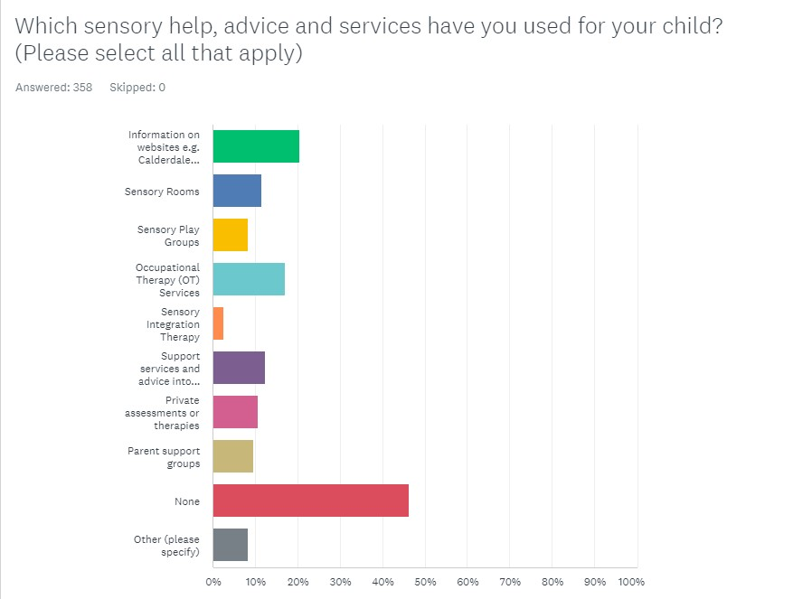
Q3 – Which sensory help, advice and services have you used for your child?
Quite a wide spread of services accessed by Parent Carers.
Several Parent Carers had accessed more then one type of support.
By far the largest proportion, however, was those who were yet to access any sensory support.
There were lots of answers in ‘Other’, which we’ll go into in the next slide.
20.39%
11.45%
8.38%
17.04%
2.51%
12.29%
10.61%
9.50%
46.37%
8.38%

Slide 8
Q3 CONT – Which sensory help, advice and services have you used for your child?
Responses to ‘Other’:-
“No services as a parent, OT as a professional.”
“At work [we have accessed] the therapy team we have.”
“[Haven’t accessed anything yet] though I do believe this would be useful and will be something I look into.”
“Never been offered it but my child has always struggled so much with this.”
“Been to Invictus wellbeing.”
“Support Group.”
“I have not been able to access [any] of these as the availability of sensory [support] is not common knowledge.”
“Didn’t know there was any [support], no real guidance to show you about sensory or disability.”
“There isn’t a lot of help in Calderdale, we can’t even get a sensory report done.”
“There is nothing available in Calderdale.”
“Not been given any advice about groups yet; I’m really struggling with my daughter.”
“My daughter has ASD. I am aware of the services but have not gained any sensory through those relevant services.”
“The therapy accessed was not in Calderdale, but was invaluable but have not been able to build on this at all locally or at reasonable cost. Nothing useful on local sites other than most basic and obvious or for very very young children.”
“[We spoke to the teacher] about the sensory room at school.”
“FreshStart kids assessment through CCG funding.”
“IFR granted by GP – awaiting sensory OT assessment.”
“School support.”
“SALT.”
“I am waiting for my son to receive a sensory assessment through OT.”
“We travelled to Barnsley for private assessment.”
“I was unaware school services existed.”
“Diagnosed at an older age so no help available.”
“Children’s centres.”
“There was a little sensory room at [the] Jubilee Centre.”
“Own research and learning.”
“Therapy in Praxis, Knaresborough: Sensory Attachment intervention (commissioned by One Adoption.)”
“Jubilee centre.”

Slide 9
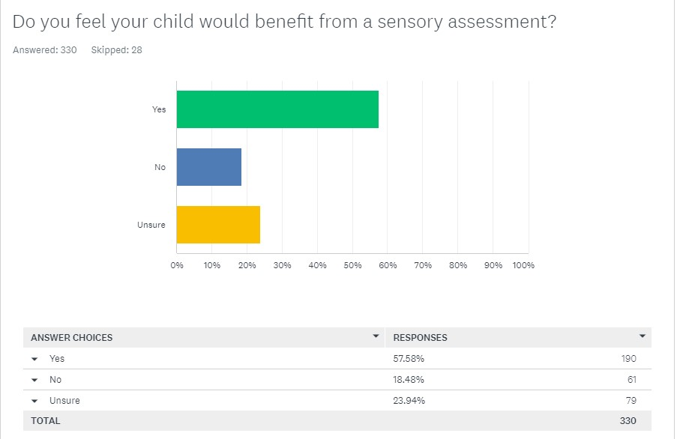
Q4 – Do you feel your child would benefit from a sensory assessment?
Pretty overwhelming in terms of the amount of people who feel they would benefit from a sensory assessment.
2nd highest answer was people who are unsure.
61 people said they would not benefit. As we will see later on, 37 people have already had an assessment.
This leaves 24 people who have never had an assessment before who do not feel their child would benefit. This is 7.27%.

Slide 10
Q5 – “If yes, how do you think your child would benefit from having an assessment?”
There were 178 responses to this question, so we have tried to categorise rather than sharing each individual response.
We will share some examples on the next slide.
“It would help the family support the CYP” –this is where a response expresses that the assessment will help them put strategies in place.
“Give the family a greater understanding.” – this is where a response expressed that the assessment will help them learn more about sensory needs.
“It would help the CYP understand themselves.” - this is where a response expressed that an assessment would help the Child/Young Person who is having issues to better understand what they are going through.
“Would help get additional support from services.” – this is where they indicated an assessment would help them get further support, such as from GP, CAMHS, etc.
“Would help het support in school.” – this is where it was indicated an assessment would help put things in place in a setting, like regional adjustments.
“It would help the CYP develop” – this is where an answer indicates support would help the CYP to progress, whether it’s with social skills, independence, etc.
Some examples on the next slide.

Slide 11
Q5 CONT– “If yes, how do you think your child would benefit from having an assessment?”
These are some example responses to this question:-
“Being able to tailor strategies to his specific challenges and understanding more around how he processes things.”
“I think he would benefit if the school had better understanding and he had a sensory break space.”
“Information is key to knowing how to help.”
“They have a few sensory issues and would be good to know why and how to manage this.”
“I think this will help her to be able to communicate her emotions.”
“I feel a sensory assessment would help me to better pinpoint and how to help support him.”
“Would help me understand and cope better with meltdowns and help his mental health.”
“To give him that extra push he needs in confidence and concentration.”
“Will be able to manage his behaviour and for him to be able to express himself to a certain extent.”
“So my child can understand [themselves] a bit better and feel safe.”
“Help her and others including teaching staff understand her needs and behaviours.”
“My child has a lot of sensory needs but these are often overlooked. These needs have become more extreme the older he becomes. It would be fantastic to have these needs assessed and the appropriate support offered.”
“I believe if we had a little bit more knowledge on how his senses are working and what we could avoid or if we could help in any way.”

Slide 12
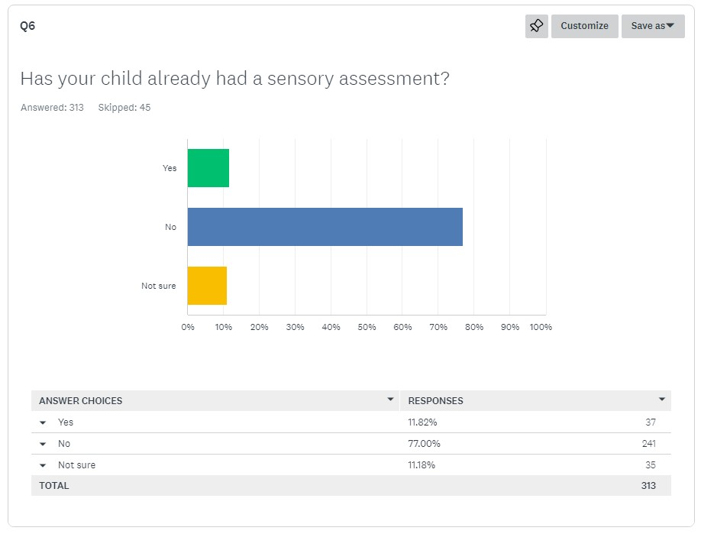
Q6 – Has your child already had a sensory assessment?
Only 12% of respondents had a child/young person who had already had a sensory assessment.
There is also 11% who are unsure – not sure whether these cases are down to a break down in communication.
The overwhelming majority have not had an assessment.

Slide 13
Q7 – Please provide any additional comments about your child’s sensory assessment.
There were 53 additional comments on this question. We will include some positive and negative examples below.
Positive
“It was fantastic. Now it’s getting the recommendations into practice that is proving difficult.”
“It was a good assessment very thorough and invaluable.”
“Absolutely brilliant, by far a better report than the ADHD/ASD one.”
“This made a huge difference to our family but could do with being updated every 7 years for changing demands, development and needs.”
“The private sensory assessment was the one thing that finally explained what was going on and why some more obvious challenges weren’t responding to support and the sensory issues were a hugely contributing factor. It was the key to everything.”
Negative
“We did the sensory passport but never got a reason or explanation of it’s outcomes. Never saw the outcomes.”
“Was refused assessment due to funding in Calderdale.”
“My child was diagnosed and received treatment for sensory processing disorder out of area. When we moved to Calderdale this diagnosis was not recognised, and no continuing care was provided. School have implemented their sensory diet originally provided out of area, but this is now several years out of date.”
“Getting professionals to listen and do a referral is a nightmare.”
“Tried to approach GP but was made to feel like [a sensory assessment] was not needed.”

Slide 14
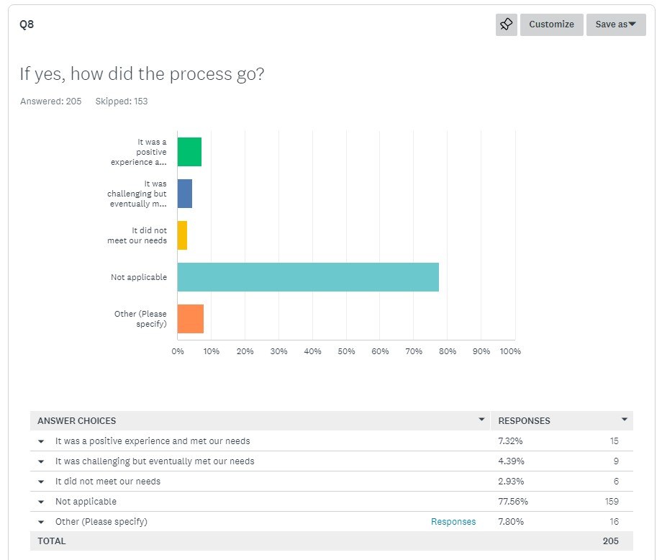
Q8 – If you child has had a sensory assessment, how did the process go?
This question was not applicable for the vast majority of survey respondents.
We will calculate percentages based on those who didn’t answer ‘Not Applicable’ or ‘Other’.
This leaves a remaining 30 respondents
50% of which said ‘it was a positive experience and met our needs’.
30% of which said ‘it was challenging but eventually met our needs’.
20% of which said ‘it did not meet our needs.’
This is a very small sample of people who’ve actually been through the process, but it’s good to see 80% had needs met.
A lot of the ‘other comments’ either had more context or were not relevant to this question.

Slide 15
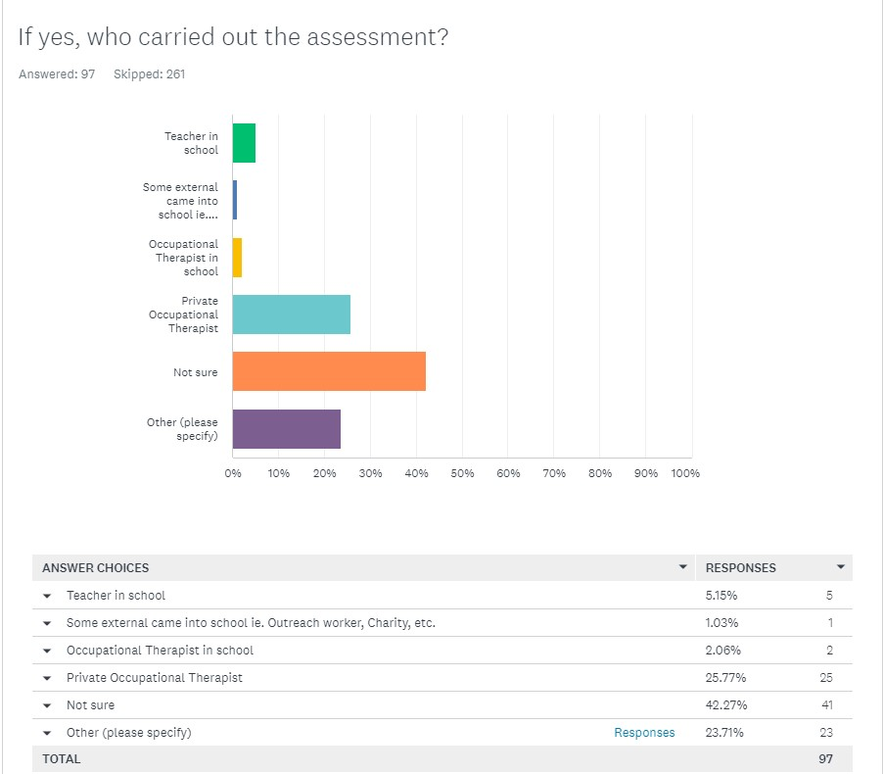
Q9 – If you had a sensory assessment, who carried it out?
There was a lot of people who answered not sure, or answered NA under Other. We’ll do some percentages based on the people who picked out an option, which was 33 people.
76% had their assessment from a Private Occupational Therapist.
15% had their assessment from a teacher in school.
3% had their assessment via an external person coming into school.
6% had their assessment via an occupational therapist in school.
There were a few variants listed under ‘Other’; ‘hospital’, ‘clinical psychologist’ and ‘SALT’.

Slide 16
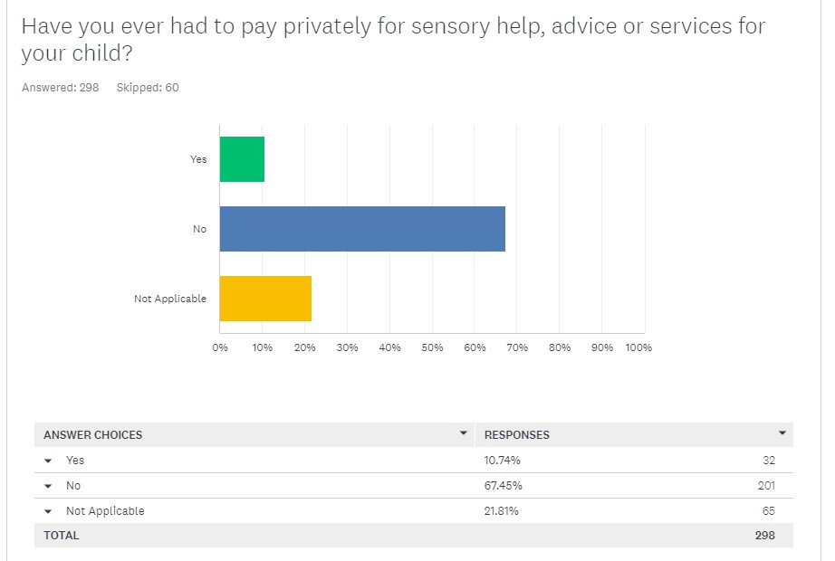
Q10 – Have you ever had to pay privately for sensory help, advice or services for your child?
47% of respondents indicated they have never accessed any sensory help or support for their child, so these respondents will fit into both the ‘No’ and ‘Not applicable’ category in this question.
There are quite a lot of free support options in Calderdale, such as peer support, coffee mornings etc which people can access.
There is still, however, a burden on Parent Carers to spend money when accessing more specialist support.

Slide 17
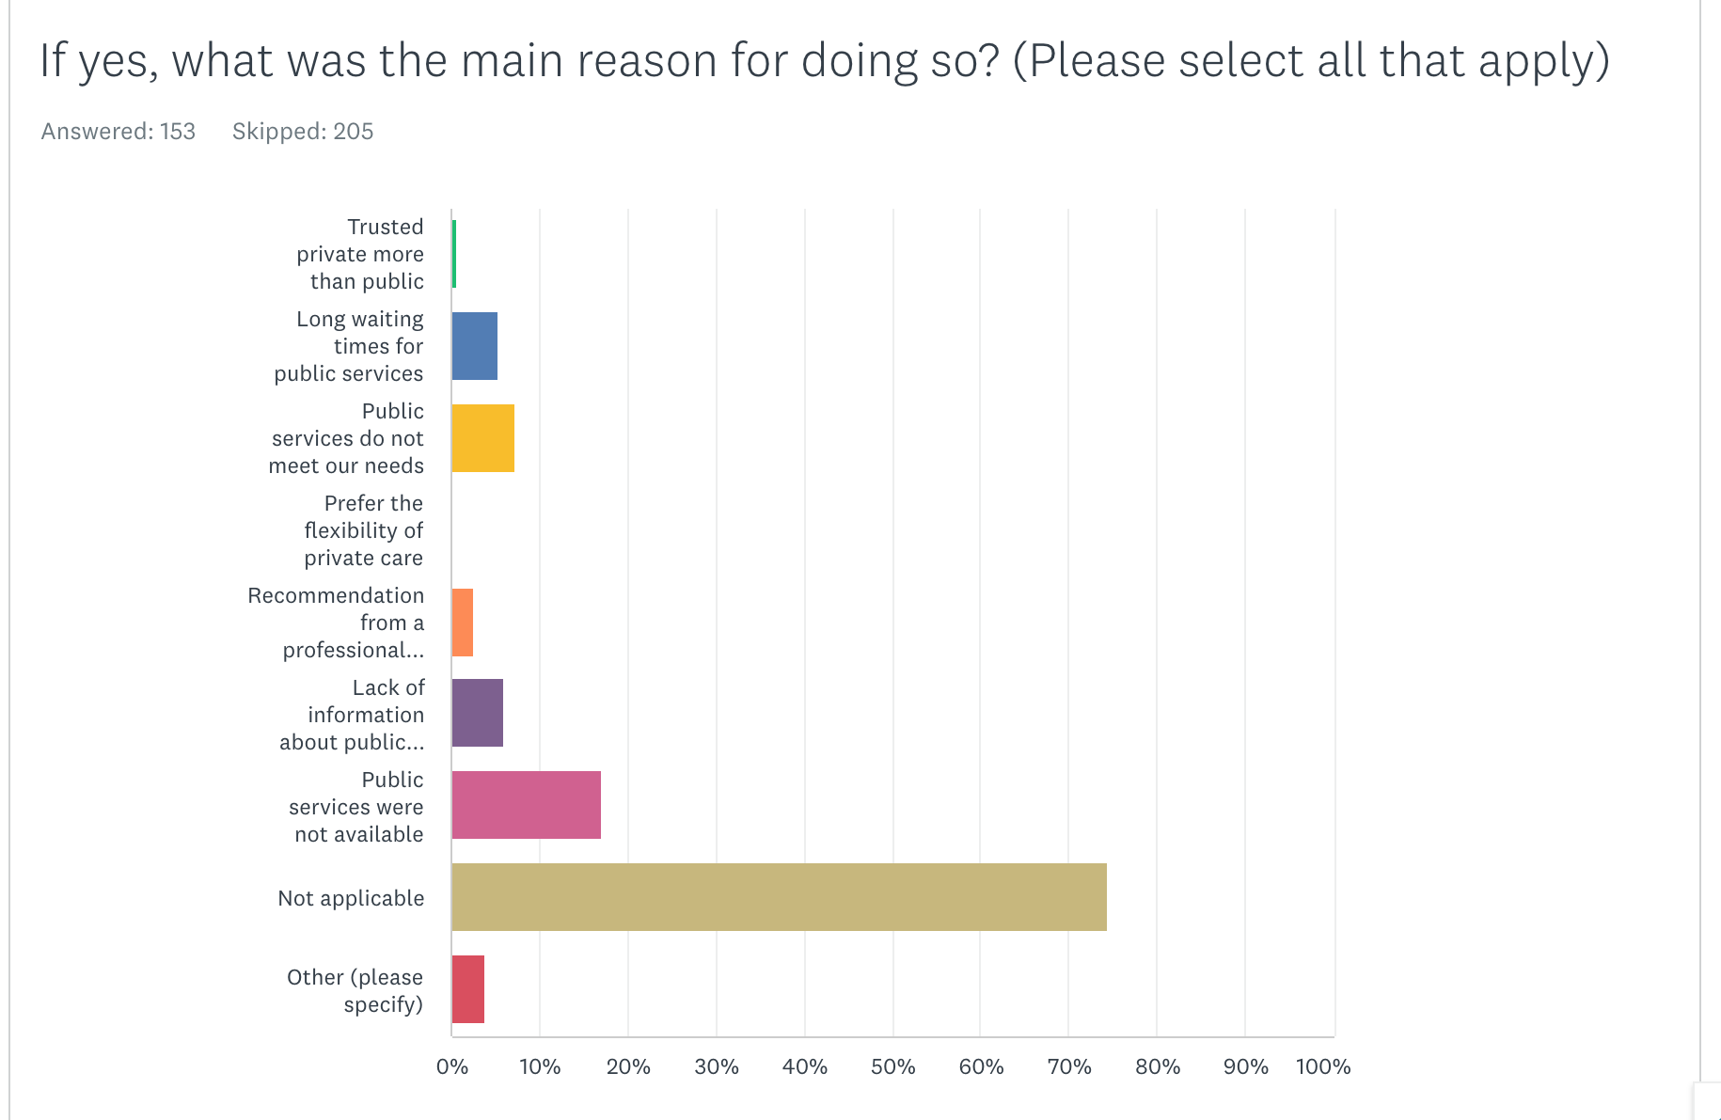
Q11 – If yes, what was the main reason for doing so?
74% of people answered 'Not applicable', so we have calculated the percentages based on the percentage of those who didn’t select 'Not Applicable'.
Of the people who didn't answer 'Not Applicable', the biggest reason (40%) for using private services was a lack of public services.
The lack of public sensory services is reflected across the rest of the survey responses as well.
In 'other', two answers have referenced they are currently waiting to see if they can get funding.
Another answer referenced they had paid for specialist toys and sensory play.
1.5%
12.3%
16.9%
0%
6.2%
13.8%
40%
9.2%

Slide 18
Q12 – If yes, how much did you pay?
Not a lot of people have progressed to the stage (or can afford to) pay privately for sensory services and assistance, but several people have indicated that they have paid and given some information on how much it cost.
Some have given an overall cost, whilst some have given hourly rates. We will work out averages for each.
The average overall price for those who indicated an overall cost on the survey was £828.
For those who indicated an hourly rate, the average was £62 per hour.
This can allow us to extrapolate the date out more widely.
If all 358 people who filled out this survey were to have to pay privately, this would add up to £296,424.
Studies have indicated that 5-16% of children exhibit symptoms of sensory processing disorder. (Ahn, Miller et. al., 2004; Ben-Sasoon, Carter et. al., 2009).
As of April 2024, Calderdale has 19,057 pupils in primary schools and 16,798 pupils in secondary schools. (35,855 total)
Here are some costs based on those numbers:
If 5% of these families paid privately, it would cost £1,484,397 based on an average cost of £828.
If 16% of these families paid privately (upper end of the SPD symptoms prevalence estimate), it would cost £4,750,070 based on an average cost of £828.
This shows the potential scale of the cost burden for private sensory services in Calderdale.

Slide 19
Q13 – If yes, what did you pay for and where?
People indicated the support they had paid for; some people paid for multiple children so this is reflected in the numbers.
Some answers indicated they couldn't afford anything and some of these comments have been included below.
"I wouldn’t be able to pay privately, so I haven’t bothered to look"
“No way can I pay privately for an up to date assessment"

Slide 20
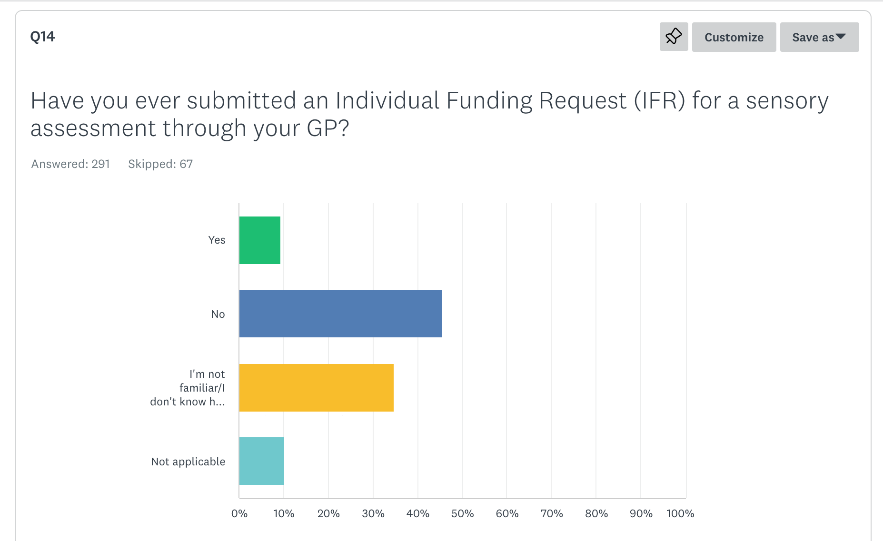
Q14 – Have you ever submitted an Individual Funding Request (IFR) for a sensory assessment through your GP?
Very few respondents had indicated they had submitted an Individual Funding Request.
A large proportion of people indicated they were not familiar with IFR's or didn't know how to request one.
This generally aligns with the comments throughout the survey, and indicates a potential area for awareness raising.
9.3%
45.7%
34.7%
10.3%

Slide 21
Q15 – If yes, what was the outcome of this request and what were the reasons given?
We have categorised this into approved requests, not approved, and those still waiting for the outcome.
Of those who were rejected: 57.1% due to lack of evidence. No reason given for the remainder.
Some example comments:
"It was bounced around between services for over a year and nothing came of it."
"It was successful because needs quite extreme and supported by range of different professionals."
"It was declined. They stated I needed evidence to state she needed the assessment!"
"Still waiting to see if this will be accepted. GP was unaware that this could happen/of what to do."
"Refused. No reason given."

Slide 22
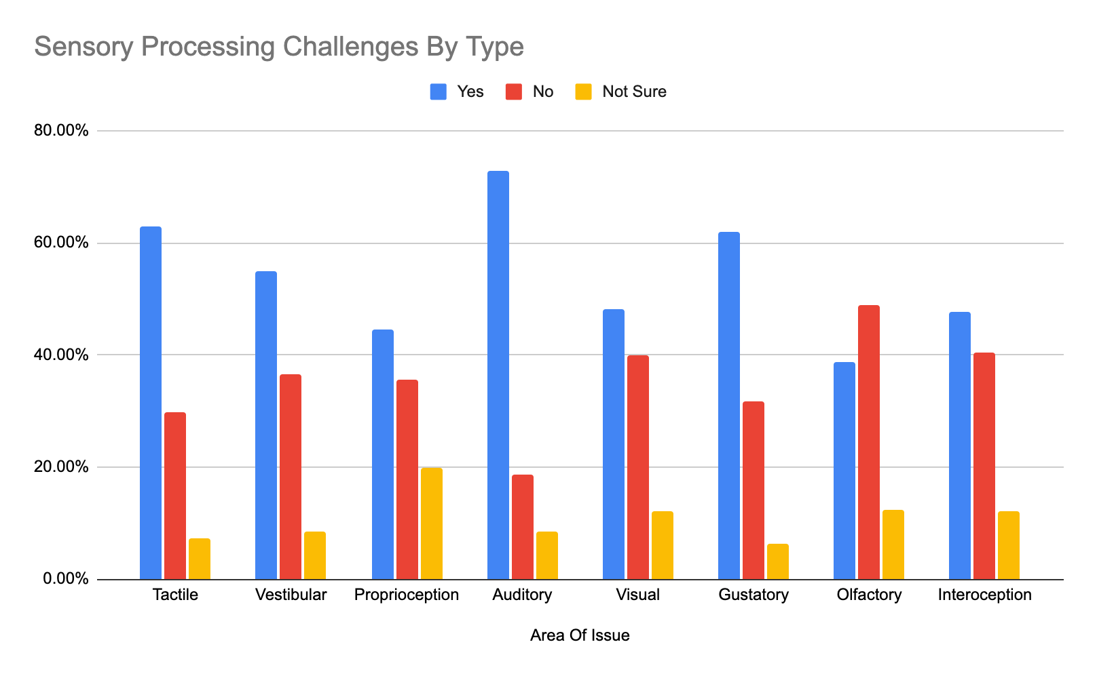
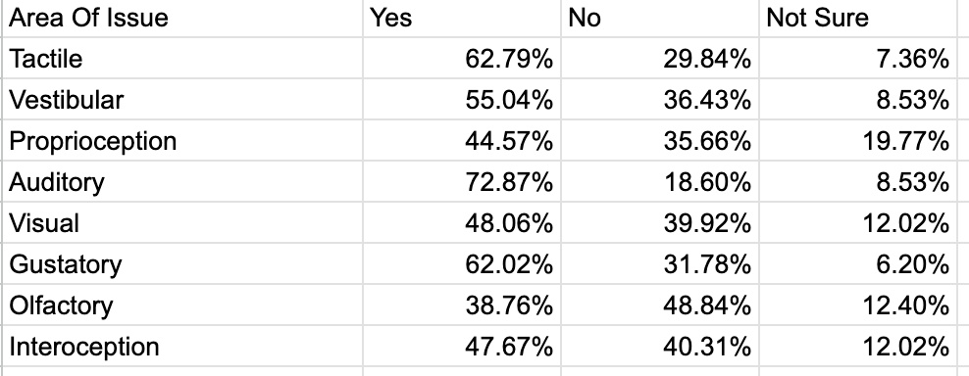
Q16 – Which areas of sensory processing does your child have challenges with?
This question allowed families to answer yes/no/not sure to each individual area of sensory challenges.
The areas were: Tactile, Vestibular, Proprioception, Auditory, Visual, Gustatory, Olfactory, Interoception.
Many children and young people have issues across multiple areas.
Auditory is the highest, olfactory the lowest.
We included explainers of each area.
Actual numbers below.

Slide 23
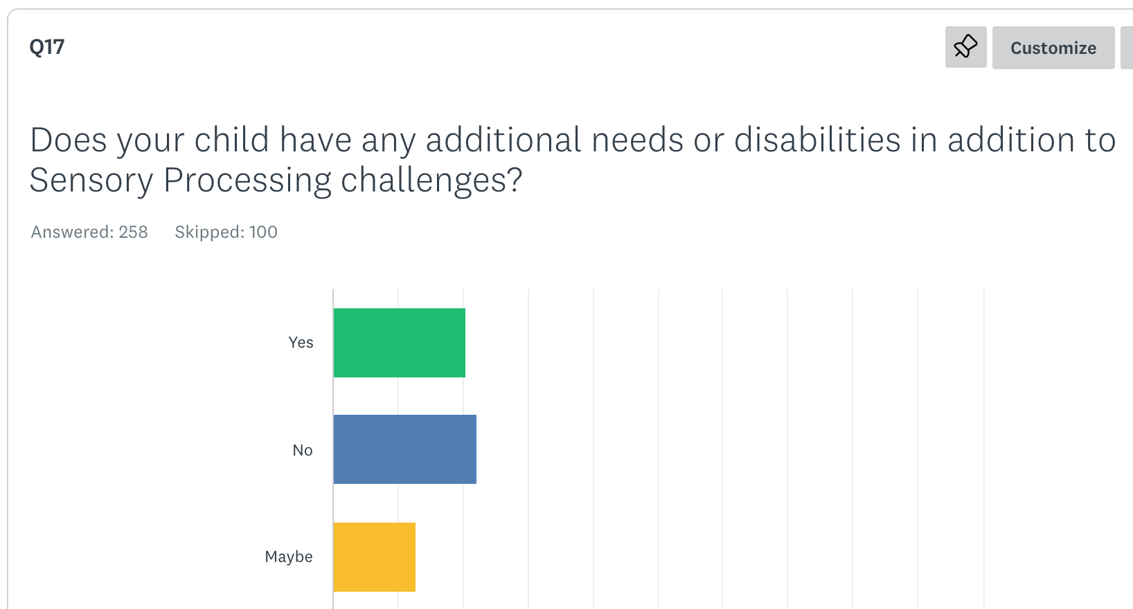
Q17 – Does your child have any needs or disabilities in addition to Sensory Processing challenges?
There are some individuals or groups who are far more likely to have Sensory Processing challenges.
For example, over 96% of children with ASD report sensory behavioural differences (National Institutes of Health).
Yet a significant proportion of respondents have Children/Young People who only have Sensory Processing Challenges.
We asked for more details which we will go into in the next slide.
37.1%
39.9%
23.1%

Slide 24
Q17 CONT – Does your child have any needs or disabilities in addition to Sensory Processing challenges?
By far the highest additional challenges were Autism & ADHD, with 65% of respondents to this question having a Child/Young Person with a diagnosis or going though the pathway.
9% of respondents selected ‘other, and the answers covered a wide range of areas: Epilepsy, Tourette's, ARFID, West Syndrome, Dyscalculia, Irlen's Syndrome, DCD, Prader Willi, NG Fed, OCD, Genetic, PICA, Trisomy 21, 16p12.2 Chromosome deletion, FASD, Metabolic Condition.

Slide 25
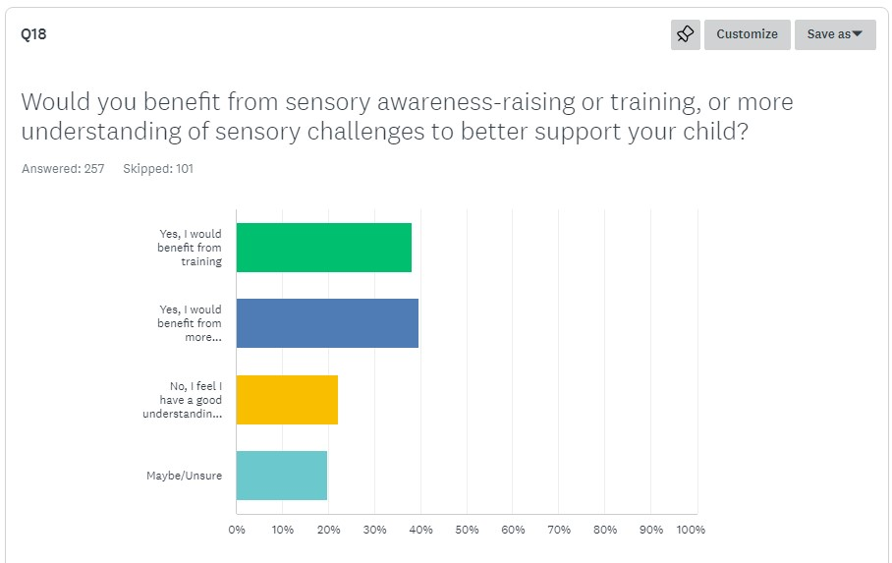
Q18 – Would you benefit from sensory awareness-raising or training, or more understanding of sensory challenges to better support your child?
Fairly self explanatory, most people feel they would benefit from learning more.
22.2% feel they have a good understanding, leaving a potential 77.8% with the potential to learn more.
38.1%
39.7%
22.2%
19.8%

Slide 26
Q20 - What types of sensory services do you feel would benefit you but are not available locally?
The largest answer was people who simply didn’t know what sensory services would benefit them that weren’t currently available.
This widely overlaps with the rest of the survey which indicates more information about sensory would be key.
Of the specific areas chosen, a need for Sensory Assessments (on the NHS and recognised by the NHS) and Occupational Therapists were the highest.

Slide 27
Q23 - What additional help, advice or services would you like to see introduced or increased in Calderdale?
This question gave us some further insight into general gaps within Calderdale.
Around 25% of Survey Respondents answered this question.
Sensory Support is the largest area, but this will likely be much higher than it would be otherwise due to this being a sensory specific survey.
Under ‘Other’, there were lots of specific areas mentioned just once: Breastfeeding Support, Improvements to the Local Authority, Pathological Demand Avoidance, Less Parent Blaming, Deaf & Blind awareness, Speech and Language Therapies, Pre-verbal assistance, Avoidant/Restrictive Food Intake Disorder.

Slide 28
Q22 – Any final comments?
There were 21 additional comments at the end, some were feedback on how the survey was conducted but we have highlighted some comments from Parent Carers about services themselves.
“I think in addition to the sensory information it is good to raise awareness of masking. My eldest in particular masks all day at school, so receives no support there as they see no need for it. But then she explodes at home!”
“Sensory is still seen as something specialist rather than linked to most ND and it’s often treated as something made up unless there is an autism diagnosis alongside it. It is not understood by gatekeepers who could allow access to support and reasonable adjustments or those who would be able to create enabling environments if they would just understand the issues.”
“There should be more funding towards SEN children in schools.”
“A huge boost in funding to increase capacity to give advice and advocacy by our excellent local charity Unique Ways. The preventative value by addressing need earlier would be vast e.g reduce demand on MH services, reduce school exclusion etc etc - NHS or other funders would get a good return on investment” – we did pick this one out especially!
“I found out about the IFR by accident, otherwise my child would still.be struggling. Diagnosis has been given & recommendations on the report given, but that's as far as anything went. As will all assessments we've had, we are simply left to get on with it. GP services need to be made fully aware of the process & who to refer to once funding is granted. We were delayed 8 months as our GP left it to us to find a provider, yet one phonecall to the CCG gave me all the information I needed.”
“Sensory issues are the lynch pin that impacts on every area of need. It massively affects all ASD/ADHD traits and challenges. Getting sensory support is the difference between being able to cope and focus on any given day.”

Slide 29
ABOUT FAMILY VOICE CALDERDALE
Family Voice Calderdale is a project of Unique Ways and is the Parent Carer Forum for Calderdale.
All Parent Carer Forums are members of the National Network of Parent Carer Forums and Contact (formerly Contact A Family).
The aim of Family Voice Calderdale is to ensure that services within Calderdale meet the needs of disabled children and their families
We do this by representing the voices of the Parent Carers of Children and Young People with SEND in Calderdale, and by having Parent Carer Representatives sit on Strategic Partnerships throughout Calderdale.

Slide 30


KEEP IN TOUCH
Leah Webster
Family Voice Calderdale – Volunteer Chair
Leah.webster@uniqueways.org.uk
Joe Thompson
Family Voice Calderdale – Project Co-Ordinator
joe.thompson@uniqueways.org.uk
01422 343 090
Working pattern: 9:30-3:30, Tuesday to Thursday
Unique Ways, Hanson Lane Enterprise Centre, Hanson Lane, Halifax, HX1 5PG
Company Number: 05098716 | Charity Number: 1109413

