Slide 1

Mediation Survey 2024

Slide 2
BACKGROUND / CONTEXT
As part of the CHANGE Programme, the Local Authority were keen to hear the views and experiences of Parent Carers and Children/Young People of the Education, Health and Care Plan (EHCP) Mediation process.
This survey was very short (6 questions) and had a short timeline to respond of 5 days.
Number of recipients of the survey: 1852
Number of completed surveys: 29
Please note that the numbers were lower as this survey was only up for a few days and has quite a niche topic, hence the relatively low numbers of completion.
As Mediation is something that only a select number of people have experienced, we anticipated that the number of responses would be lower than some of our other surveys.

Slide 3
Questions We Asked
Have you, or are you currently, going through the process of obtaining an EHCP (whether successfully or otherwise)?
Have you accessed mediation as part of the EHCP process?
If you didn’t access mediation, what were the barriers preventing you from doing this?
How would you score your experience of mediation (1-10?)
If you did access mediation, please describe your experience of the mediation process?
We also asked if we could use people’s answers to feedback as well.
Notes:
Locality of Respondents
Outside Calderdale – 5 which represents 2%
Lower Valley – 73 which represents 27%
Upper Valley – 52 which represents 19%
Halifax North & East – 86 which represents 31%
Halifax Central – 59 which represents 21%

Slide 4
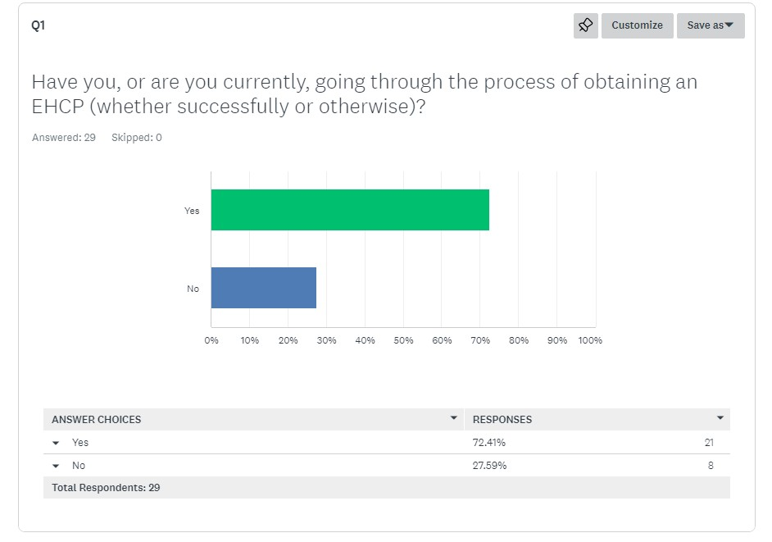
Question 1 Stats

Slide 5
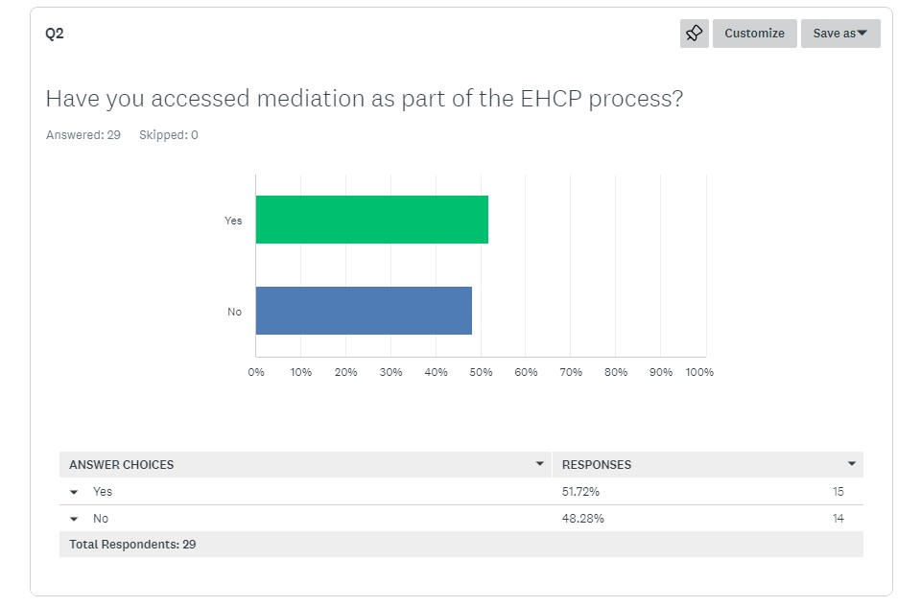
Question 2 Stats

Slide 6
Question 3 - Barriers to accessing mediation
As part of the survey, we made sure to ask Parent Carers who didn’t access mediation what the barriers were which prevented them from doing so. We won’t share details, but here are some of the themes:-
Having a poor relationship with the mediators.
Lack of knowledge about the process of mediation.
Being persuaded to not go through the process.
A lack of support or reasonable adjustments for Parent Carers to enable them to attend.
A poor level of support from the mediation service.
Mediation agreements not being adhered to.
So quite a variety of issues and some bad experiences, that have led to people being put off mediation.

Slide 7
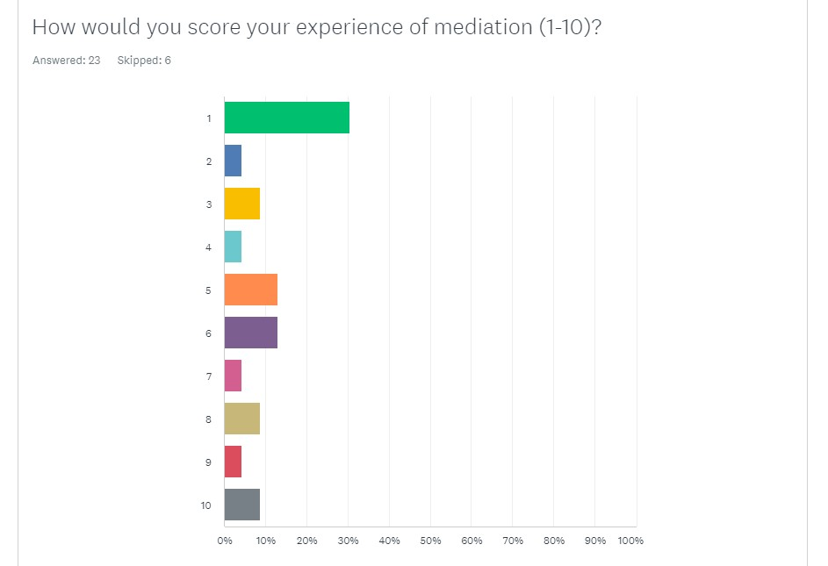
Question 4 Stats
To summarise these further, we have used the ‘Net Promoter Score’
Of the 23 answers, 74% were ‘Detractors’ (0-6).
13% were ‘Passive’ (7-8).
13% were ‘Promoters’ (9-10).
This gives a ‘Net Promoter Score’ of -61.
Combining this with looking at the scores, it paints a picture that overall people who are accessing mediation are not having a good experience with mediation.
It is also worth bearing in mind that although 15 people accessed mediation, 8 additional people scored mediation.
These additional people were ones who had barriers to access which reflected on their experience of the process.

Slide 8
Question 5 – Experiences Of Mediation
We asked people as part of the survey to give their experience of mediation when they went through it. This was a mixed bag, as indicated in the stats from the previous slide. Without giving out personal details, here are some quotes:
“Terrible. Didn’t want to listen.”
“Waste of time.”
“The meeting went well.”
“The LA agreed a number of actions and failed to carry them out.”
“Very good.”
“I felt heard by the mediator. However dates agreed during mediation were not adhered to by the LEA.”
“The process was fine. The mediator explained everything well, but I wish there had been more of an exchange of information beforehand.”
“Two experiences, one helpful, [the other was a] complete waste of time.”
“I really enjoyed it, the mediator was really lovely.”
“Mediation was good, process was easy, however, LA failed to act on what was agreed at mediation.”
“Have used twice. First experience good. Second was a waste of time as the LA officer did not follow through what was agreed.”
“It highlighted the failure of the LA”
“Was helpful in explaining the whole process.”
So a very clear mix of experiences here, and a lack of consistency in those experiences.

Slide 9
ABOUT FAMILY VOICE CALDERDALE
Family Voice Calderdale is a project of Unique Ways and is the Parent Carer Forum for Calderdale.
All Parent Carer Forums are members of the National Network of Parent Carer Forums and Contact (formerly Contact A Family).
The aim of Family Voice Calderdale is to ensure that services within Calderdale meet the needs of disabled children and their families
We do this by representing the voices of the Parent Carers of Children and Young People with SEND in Calderdale, and by having Parent Carer Representatives sit on Strategic Partnerships throughout Calderdale.

Slide 10


KEEP IN TOUCH
Leah Webster
Family Voice Calderdale – Volunteer Chair
Leah.webster@uniqueways.org.uk
Joe Thompson
Family Voice Calderdale – Project Co-Ordinator
joe.thompson@uniqueways.org.uk
01422 343 090
Working pattern: 9:30-3:30, Tuesday to Thursday
Unique Ways, Hanson Lane Enterprise Centre, Hanson Lane, Halifax, HX1 5PG
Company Number: 05098716 | Charity Number: 1109413

