Slide 1

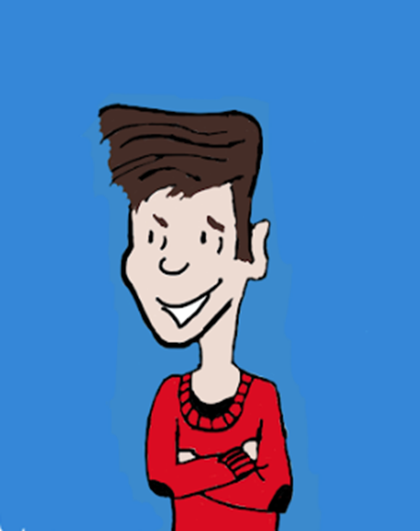

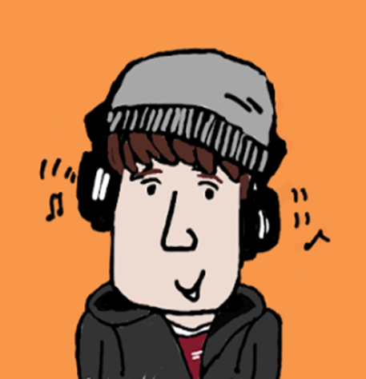

Young Leaders Summer 2018

Slide 2



What is Young Leaders?
Young Leaders is a course for people aged 16 and 17 to
Learn leadership skills
Make new friends
Try something new
It is run by Inclusion North and Lead the Way

Slide 3


Who is the course for?
It is for young people in Calderdale aged 16-17 who have a learning disability or autism, or both.
It is also for people who are aged 16 or 17 and want to be a course partner.

Slide 4



What does it involve?
The course is residential – there will be three overnight stays.
The course is free to participants.
The cost of the course will be met by Inclusion North and Calderdale Local Authority.

Slide 5



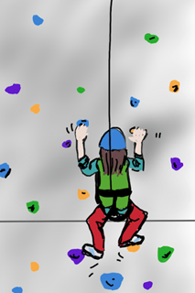
What will I do on the course?
The course will be fun, challenging and a chance to make new friends.
As well as learning new skills,
there will be a chance to do activities.
These might include a climbing
wall, archery and grass sledging.

Slide 6


What about the course partner?
On the course you will work with a partner.
Your partner will be someone
who helps you on the course
and also learns with you.

Slide 7



Who will my partner be?
Your course partner will be aged 16-17 too. It could be somebody you might know.
We will try to match you with a
partner who has the same likes
and interests as you.

Slide 8


When is the course?
The dates for Young Leaders in 2018 are:
Tues 17 July
Tues 31 July – Wed 1 August
Tues 14 – Wed 15 August
Tues 28 – Wed 29 August
Young Leaders must attend every session of the course.

Slide 9

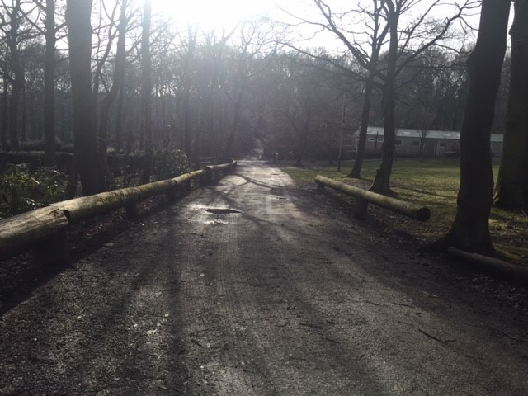
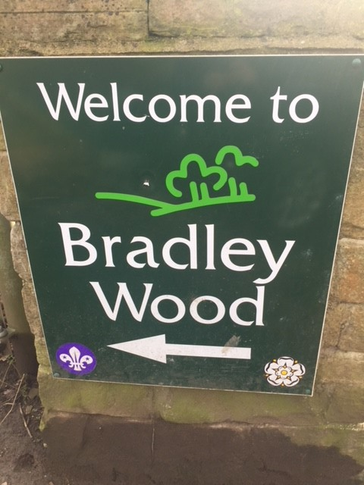
Where is the course?
The course will be held at Bradley Woods

Slide 10
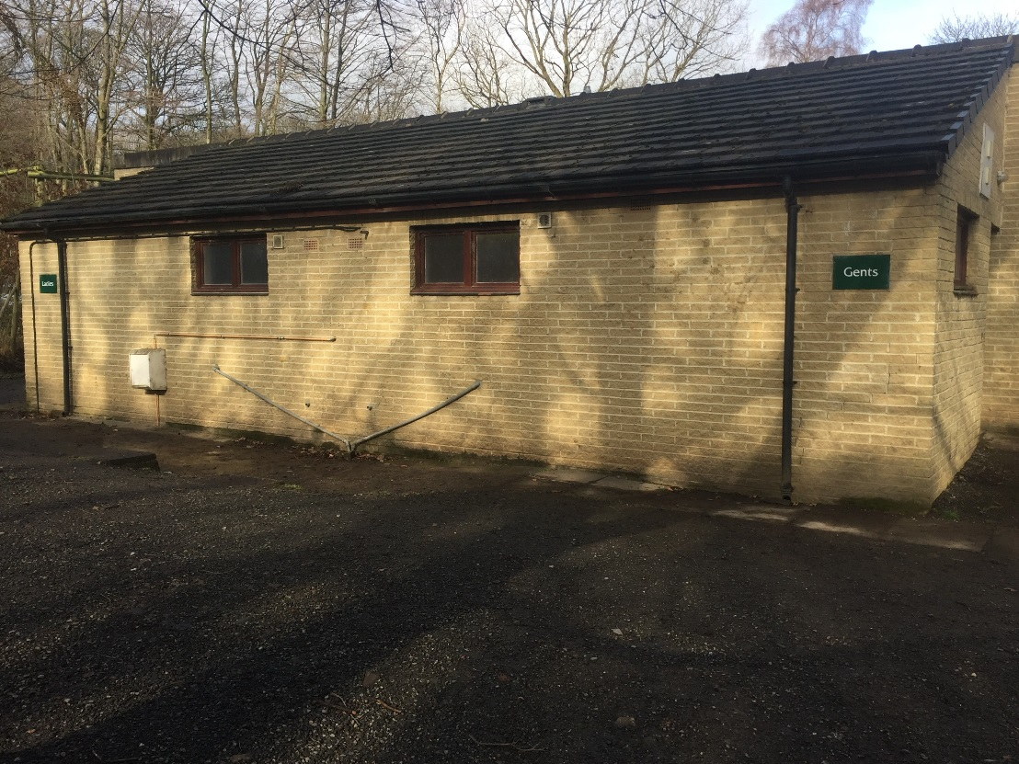
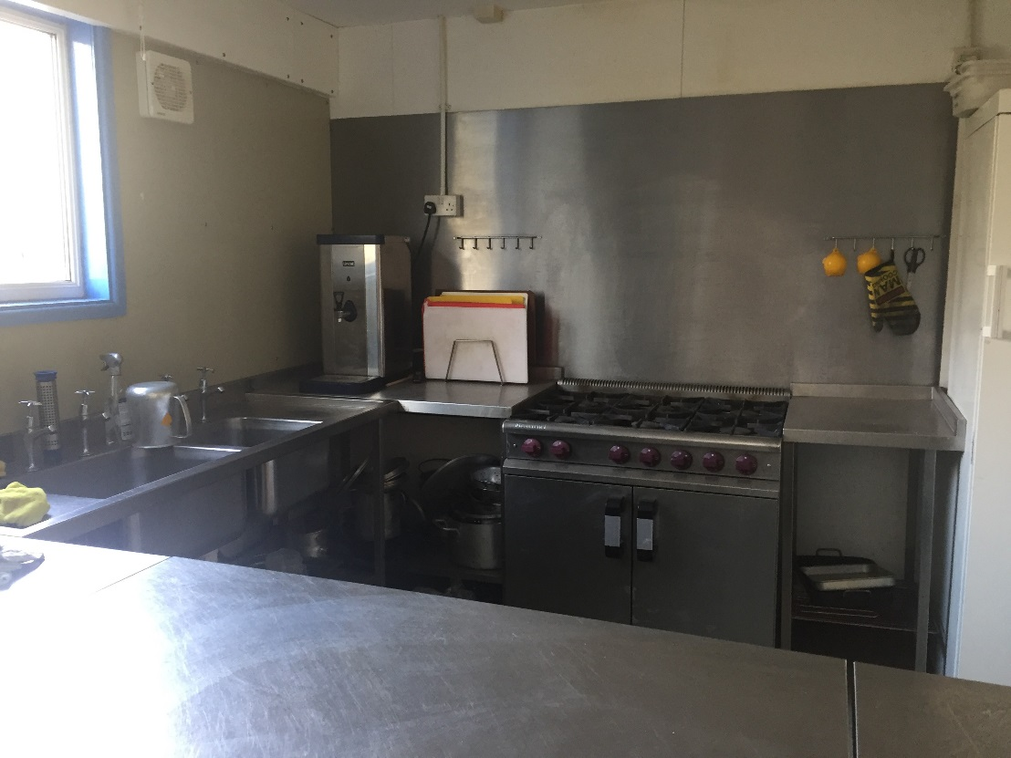

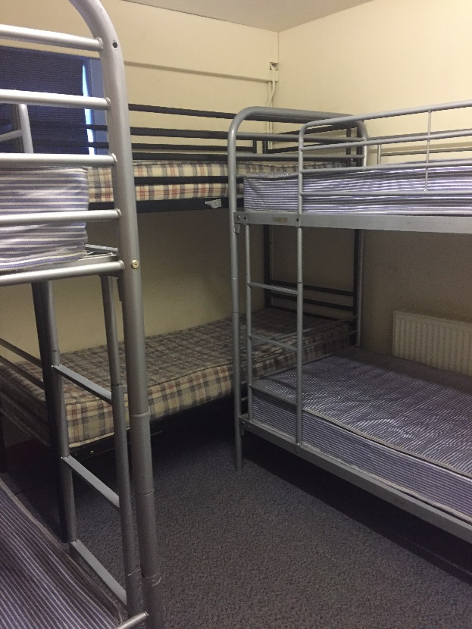
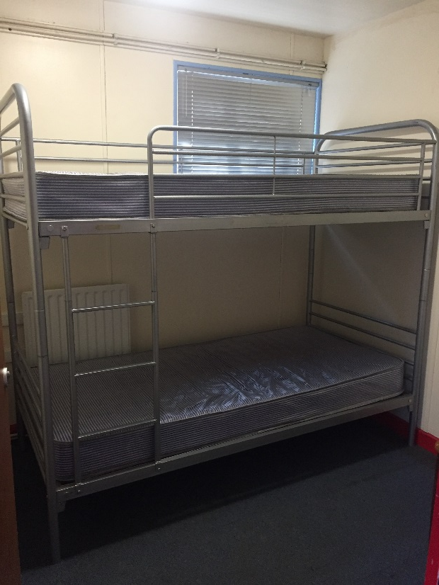
Where will I be staying?
You will be staying in the lodges at Bradley Wood

Slide 11
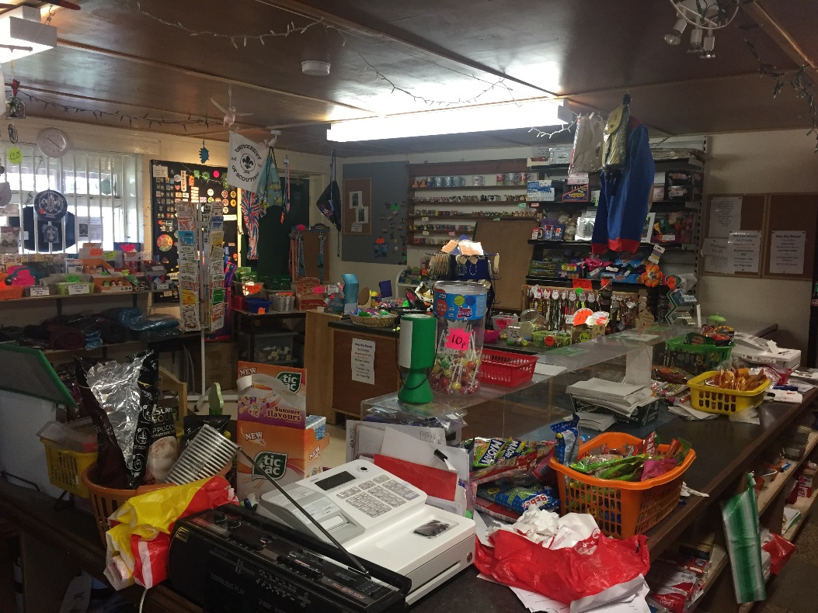
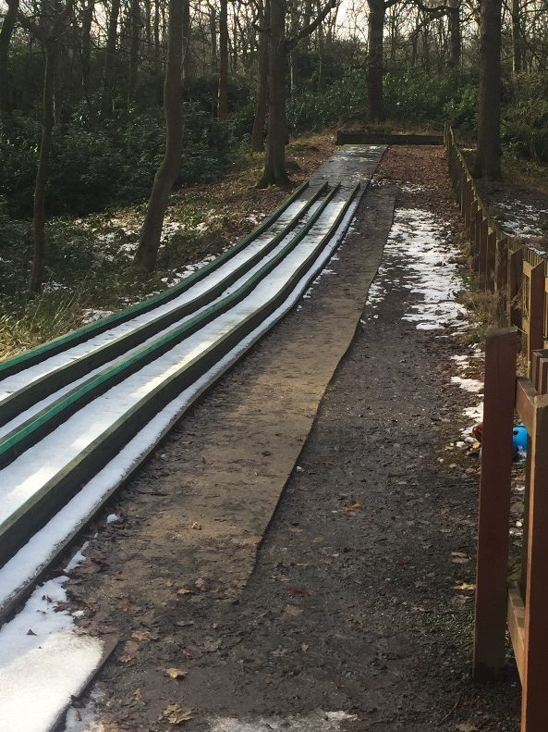
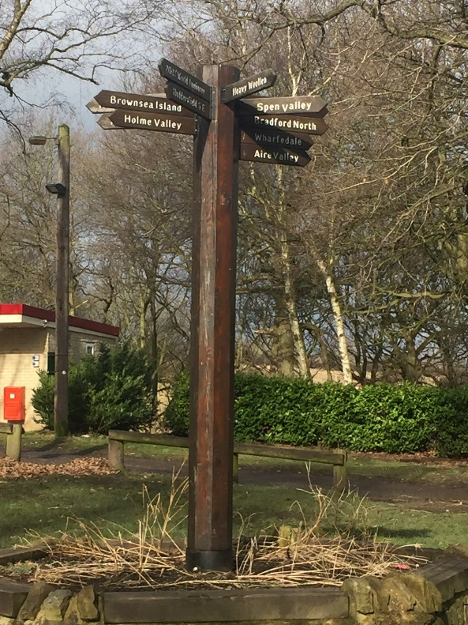
What activities will I be doing?
There will be a chance to have fun and socialise as well as activities like rock wall climbing, archery and grass sledging

Slide 12
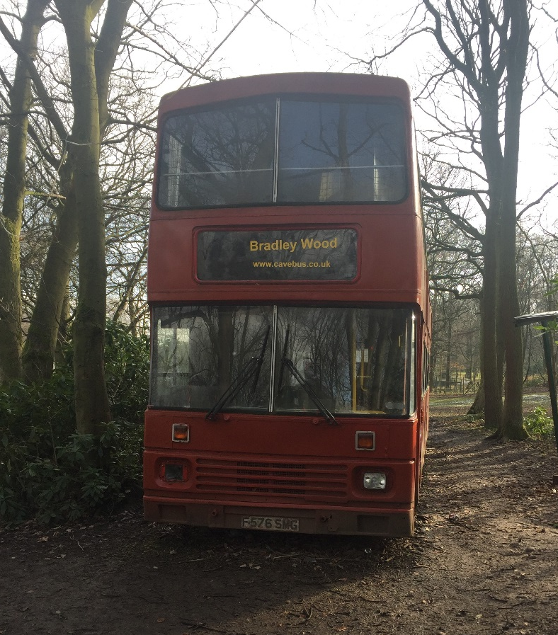
How will I get there?
Transport will be provided to get to Bradley Wood

Slide 13



How do I get a place?
You need to apply to go on the course.
We want to make sure that the
course is right for you.
You need to apply by 20th April 2018.

Slide 14


Will I definitely get a place?
Not everyone will get a place on the course. We only have 8 places for Young Leaders, and 8 places for course partners.
We will decide who goes onto the course based on your application.

Slide 15


When will I know if I’ve got a place?
We will get back to you by 4th May 2018 to let you know if you have a place on the course or not.
If you don’t get a place on the course, we will still work with you to see what other opportunities are available.

Slide 16

I want to know more!
You can ask questions now or if you think of something later, you can speak to Lead the Way by calling 0300 012 0416
You can also get help with the application
If you would like an application form you can take one now or get one later by calling Lead the Way on 0300 012 0416

